Slide 1
Chapter 5: Dynamic Analysis-Test Design Techniques
Software Testing

Slide 2
Agenda for Today
Test Object Execution
Test Bed and why it’s necessary
Systematic and Stepwise Approach for Test cases
Test Design Techniques
Static and Dynamic Testing
Introduction to Black box Testing
Functional and Non Functional Testing
Testing Approaches

Slide 3
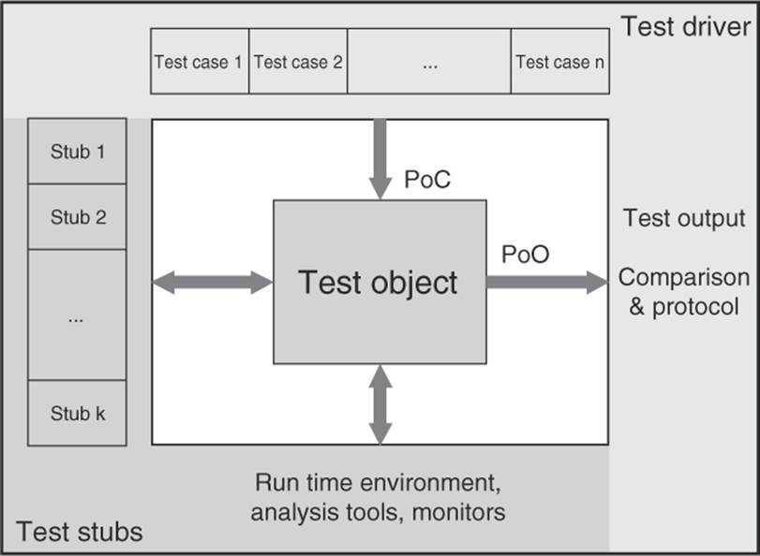
Dynamic Analysis: Test Object Execution
Test Object must be executable
- Provided with the input data
- Must be embedded in the test bed
Test Bed?
- An execution environment.
- E.g specific hardware, OS, configuration of the product under test,
other application or system software, etc.
- Drivers and Stubs combined established the test bed.
- Point of Control(PoC)
- Point of Observation(PoO)
Fig. Test Bed

Slide 4
Systematic and Stepwise approach for determining test cases
Systematic Approach:
Many requirements should be checked.
Little cost
This goal requires systematic approach
Stepwise Approach:
Determine conditions and preconditions
Specify the individual test cases
Determine how to execute the tests

Slide 5
General Test Cases Tasks
Conditions, preconditions, and goals
- What must be tested
- The failure risk should especially be taken
Traceability
- Effects of changed specifications on the test cases
- Creation of New test cases and removal or change of existing
Determining expected result and behaviour
- Results should be determined and documented
Test case execution
- Execute whole sequence of test cases

Slide 6
Software Test Design Techniques
First of all we should know
Technique?
- Efficient way
Tester design technique?
- Select good set of tests
Why we need to use the tester design technique?
- Exhaustive testing not possible
- Intelligent process needed for selection

Slide 7
Static vs Dynamic Testing
Static Testing
- Without execution
- Verification process
- Prevention of defects
- Defects finding cost is less
- Loads of meetings
- Walkthrough, Inspection, reviews etc.
Dynamic Testing
- With execution
- Validation process
- Finding and fixing defects
- Defects finding cost is high
- Lesser meetings
- Specification based, structure based, Experience based, unit testing, integration testing etc.

Slide 8
Static vs Dynamic Testing Example
Example of Online Shopping Cart
Static Test Techniques
- Review the requirement documents, design documents
- GUI of the application
- Database structure of the application
Dynamic Testing Techniques
- Functionality of the different page
- Checkout process and payment methods
- Interfaces between different pages

Slide 9
Static vs Dynamic Testing

Slide 10
Categories of Test Design Techniques
Typically we have 3 categories:
Black-box (specification-based)
White-box (structured-based)
Experience-based

Slide 11
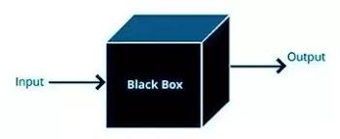
Black Box Testing
Without knowing internal knowledge
Black-Box can be any software system
Focus on the input and output
Helps in overall functionality verification
Helps in identifying inconsistent and incomplete requirements
Finds defects like: Incorrect functions, errors in data structures, behaviour, initialization etc.
Tools can be: QTP, Selenium, LoadRunner, Jmeter etc

Slide 12
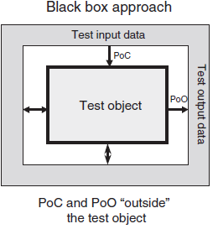
Black Box Testing
Point of observation and Point of control situated at outside the test object.
Test object can be your module/component, System.
PoC are appropriate test data, appropriate test precondition.
PoO is output, result

Slide 13
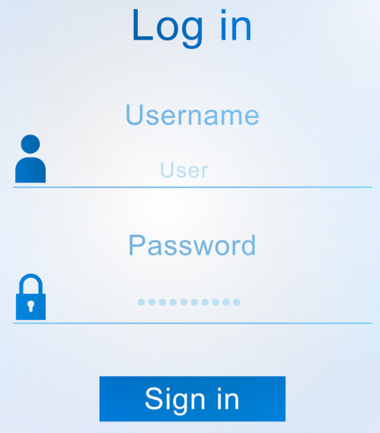
Black Box Testing Example
This form of testing technique will check the input and output.
- A user logged in when inputs correct username and correct password
- A user receives an error message when enters username and incorrect password
Black box testing checks scenarios where the system can break.

Slide 14
Black Box Testing
The generic steps followed to carry out any type of Black Box Testing.
Initially requirements and specifications of the system are examined.
Tester chooses valid inputs (positive test scenario) to check whether Software under test(SUT) processes them correctly . Also some invalid inputs (negative test scenario) are chosen to verify that the SUT is able to detect them.
Tester determines expected outputs for all those inputs.
Software tester constructs test cases with the selected inputs.
The test cases are executed.
Software tester compares the actual outputs with the expected outputs.
Defects if any are fixed and re-tested.

Slide 15
Types of Black Box Testing
Functional Testing
- Focus area is customer requirement’s
- Mainly black box involved
- Requirement
- Functionality
- Examples (Unit, Smoke, Integration testing etc)
Non functional Testing
- It focusses on customer's expectation.
- Requirements
- Functionality
- Examples ( Performance, Load, Reliability testing etc)

Slide 16
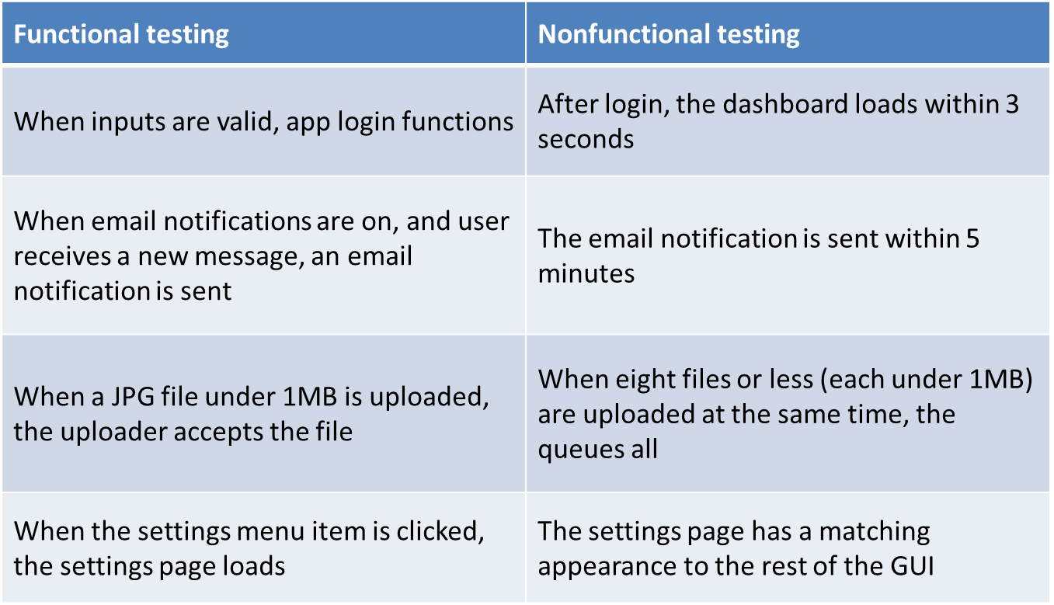
Functional Testing vs Non functional Testing Example

Slide 17
Testing Approaches
Manual Testing:
- Checks the system as a user.
- Processing time
- Not much reliable
- UI change
- Suitable when the test cases are run once or twice
Automated UI Testing:
- user interaction with the system is recorded to find errors
- Reliable
- Processing time
- Time required for automated testing is less
- Testing Tools: Selenium, Quick Test Professional (QTP) , Cross-Browser testing,
Loadrunner, JMeter etc

Slide 18
Thank you

